Slide 1

Curriculum Specifications English Form 4 & 5

Slide 2
1. OBJECTIVES
The English language curriculum enables learners to:
i. form and maintain relationships through conversation and correspondence; take part in social interaction; and interact to obtain goods and services;
ii. obtain, process and use information from various audiovisual and print sources; and present the information in spoken and written form;
iii. listen to, view , read and respond to different texts, and express ideas, opinions, thoughts and feelings imaginatively and creatively in spoken and written form; and
iv. show an awareness and appreciation of moral values and love towards the nation.

Slide 3
2. CURRICULUM SPECIFICATIONS
1. the first column states the skills to be achieved
listening, speaking, reading and writing
(do not appear as discrete items in the syllabus or in this document but are integrated into the areas of language use.)
2. the second column presents the learning outcomes set out at three levels.(Level 1 – 3)
3. examples and activities

Slide 4
3. The Curriculum Content
SECTION 1 : LEARNING OUTCOMES AND SPECIFICATIONS
1.0 Language for interpersonal Purpose
2.0 Language for Informational Purpose
3.0 Language for Aesthetic Purpose
SECTION 2 : LANGUAGE CONTENT
a) Grammatical Items
b) Suggested Sentence Patterns
c) Sound System
d) Word List
SECTION 3: EDUCATIONAL EMPHASES

Slide 5
4. IMPORTANT CONSIDERATIONS FOR TEACHING
Planning and Organization of Lesson
Learner-Centredness
Integration
Repetition, Reinforcement and Consolidation
Teaching-Learning Activities
Evaluation
Other Considerations - Malaysian setting, international exposure, moral values, and the Malaysian way of life.

Slide 6


5. CONTEXTS FOR TEACHING
People
(Values)
Environment
Social Issues
Health
Science &
Technology

Slide 7
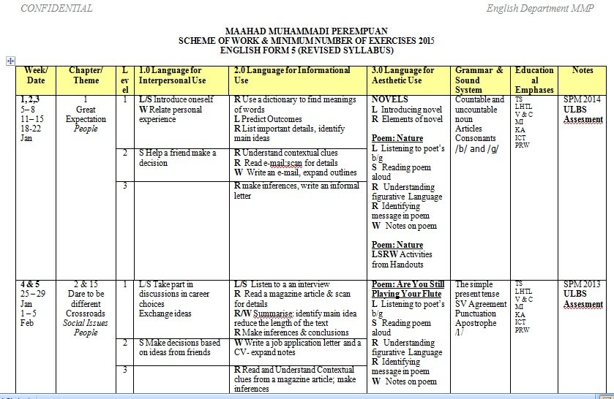

Slide 8


