Slide 1
idioms
By hook or by crook
Turn over a new leaf
Butterflies in ones tummy
To build a castle in the air
Blows his own trumpet
A cold feet
A heart to heart talk
To eat one’s heart out – suffer in silence
Hold your tongue – silent
To cry for the moon – try to get one’s beyond reach
Pull one’s leg – deceive
A snake in the grass – a secret enemy
Red letter day – important day
Living from hand to mouth
To be in a hot soup – be in trouble
Rome was not build in one day
A stich in time saves nine

Slide 2
In the pink
black sheep
Green fingers
Catch red-handed
Born with a silver spoon in one’s mouth
A close shave
A white elephant
Green light
Pass with flying colours
Cold hearted
A sweet tooth
Procrastination is the thief of time
a stone’s throw away
burst into laughter
burst into tears
apple of one’s eye
over the moon
keep in mind
rain cats and dogs
at the eleventh hour
out of the blue
blackout

Slide 3
SOPHISTICATION
IS WHEN SIMPLE WORD IS REPLACED BY GOOD EXPRESSION

Slide 4
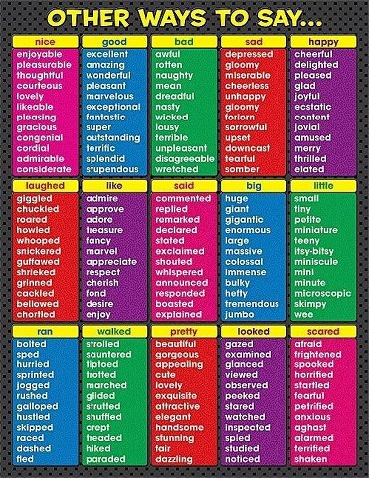

Slide 5
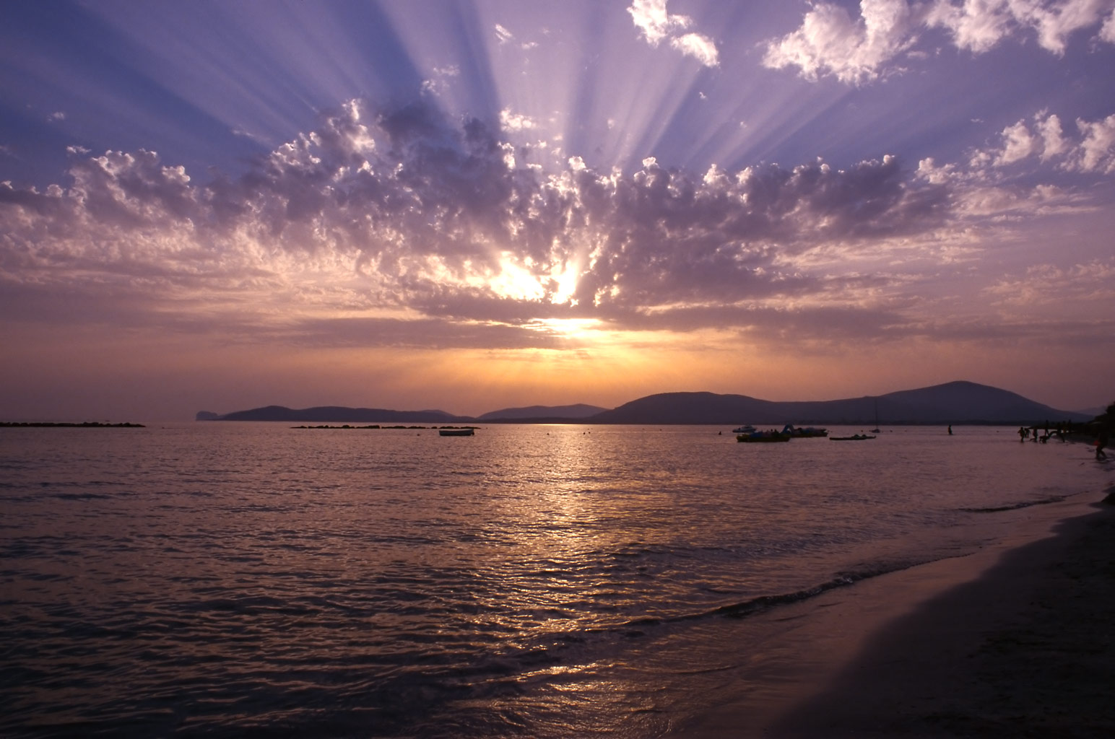
Try this… wonderful
Appealing
Bizarre
Amazing
Fabulous
Tremendous
Extraordinary
Remarkable
out of the ordinary
Fascinating
Compeling
Stimulating
Astounding
Magnificent
Awesome
Attractive
Mesmerizing
Convincing
Inspiring
Astonishing
Thrilling
Overwhelming
Breathtaking

Slide 6
MAKE AN EFFORT TO HAVE COLLECTIONS OF VOCABS

Slide 7
To describe weather
hot sunny windy
sunny misty magnificent
gorgeous rainy stormy
delightful stormy marvelous
glorious misty cold
fair rainy superb
fabulous lovely blazing
hot scorching wonderful
damp wet misty
dark gloomy

Slide 8
To describe food
delicious scrumptious disgusting burnt
fatty filling syrupy fresh
appetizing fresh healthy sizzling
piping hot sizzling steaming sour
spicy sticky chewy creamy
Mouth-watering well-cooked crisp crunchy
lumpy mushy soggy sugary
tough salty smooth spongy
squashy tender sweet plain
rich tough tasty oily
tough bitter plain sweet
Tasteless flat common
bitter

Slide 9
Health Vocabulary
fast food
takeout/take away
frozen foods
hamburgers
chips
soda
donuts
cakes
brownies
cookies
pizza
candy
pie
ice cream
dessert
sugary
artificial
additives
junk food
processed
genetically modified
deep fried
empty calories
unhealthy
healthy
nutrients
protein
well-balanced meal
nutritious
natural
organic
vitamins
minerals
dietary choices
whole grain
soy products
to eat right
to have energy
to be active
to be fit
to be in shape
to exercise
to play sports
to go on a diet
to lose weight
eating disorders
anorexia
bulimia
body image
skinny
thin
slim
starving to death
emaciated
malnourished
to vomit
addiction
fattening
obese
obesity
overweight
cancer
high blood pressure
diabetes
heart disease
epidemic
couch potato
to lounge around
to be lazy
to spend time V+ing
to watch too much TV
to be inactive
to gain weight
to put on weight
to snack

Slide 10
alcohol
alcoholic
binge drinking
drunk driving
liver problems
illegal drugs
prescription drugs
over the counter drugs
dependency
drug addict
to do drugs
to be addicted to
Health Vocabulary
smoking ban
second-hand smoke
tobacco
nicotine
tax
underage smoking
emphysema
lung cancer
breathing
coughing
respiratory problems
to smell bad
to quit smoking

Slide 11
Vocabulary for Disasters
A storm
bad weather
damage to property
flooded low-dying areas
heavy downpour
heavy rain
howling wind
lightning flashed across the sky
power breakdown
raining cats and dogs
roads impassable to traffic
roofs ripped off
rumbling thunder
thunderstorm
traffic congestion
uprooted trees.
An Accident
ambulance
badly injured
bang
collide
dent
first aid
fractures legs/arms
hospital
injuries
knocked down
screeching brakes
seriously wounded
shattered glass
unhurt
A Flood
boats
drown
evacuation centres
gushing waters
rainy season
reaching dangerous levels
relief centres
relief workers
rising rapidly
stalled cars
strong currents
swift-flowing
wading
weather report
A fire
burnt
chaotic
choking
crackling sounds
fire brigade
fire-engine
fire-fighters
flames
pandemonium
panic
panic-stricken
siren
smoke
suffocating
terrifying

Slide 12
A GREAT OUTINGS
Trip/Journey
enjoyable
hazardous
highway
luggage
nerve-wrecking
picturesque
pleasant
relaxing
reservations
road
scenery
steep gradient
tiring
unpleasant
winding
Camping
activities
adventures
camp-fire
cooking utensil
exciting
food
firewood
guitar
knapsacks
nearby stream
pitch
songs
tents
unforgettable
shimmering/ glittering water

Slide 13
feelings
SCARED
Freeze
Paralyze
Spook
Scare silly
Scare the pants off
Panic
Shake up
Horrified
Startled
Cowed
Petrified
Alarmed
Rattled
Faint-Hearted
Have a cold feet
MAD
unstable
crazy
insane
daft
delirious
psychotic
nutty
unsound mind
deranged
nonsensical
lunatic
rabid
foolhardy
illogical
irrational
HAPPY
Blissful
Perky
Content
Jubilant
Estatic
Lively
Delighted
Gay
Upbeat
Sparkling
On Cloud Nine
Thrilled
Chirpy
Walking On Air
Merry
FUNNY
laughable
Amusing
Antic
Good-humoured
Comic / Comical
Goofy
Humourous
Loony
Wacky
Facetious
Playful
Jesting
Funny
Pulling one's leg
Entertaining
SAD
Bitter
Morbid
Somber
Despondent
Dejected
Depressed
Down
Doleful
Downcast
Forlorn
Doldrums
Heartbroken
In The Dumps
Gloomy
Bereaved

Slide 14
feelings
PEACEFUL
calm
composed
placid
tranquil
gentle
nonviolent
mellow
unruffled
neighbourly
serene
sedate
clammed up
soundless
unmoved
could hear a pin drop
LOVING
amiable
considerate
kind
benevolent
caring
doting
devoted
warm
sweet
motherly
congenial
affectionate
adulate
be fascinated with
hold dear
TIRED
burn out
faint
strain
vex
overwork
dispirit
give out
exhausted
worn out
fed up
repulsed / had enough
sick off
melt away
wither
diminish
ANGRY
Outraged
furious
irate
incensed
sulky
cross
mad
annoyed
galled
bitter
infuriated
displeased
indignant
fuming
vexed

Slide 15
HUMAN TRAFFICKING
traffickers
abducted
kidnapped
drugged with sleeping pills
agents
raid
victims are deceived...
recruited
women experience sexual violence / physical violence
victims are usually poor,uneducated,...
syndicates
cross border human trafficking
crackdown
uncovered
police operation
FIRE
razed
put out the fire
shelter
fanned the flames
evacuated
engulfed by fire
destroyed
dejected
restrained by neighbours
dashed into the house to ....
victims
occured at...
...help douse the fire...
financial aid
injured
started in the...
ACCIDENTS
Motorcyclist
Crashed
Head on collision
freak accident
swerved
passers-by
alerted
collided
died on the spot
vehicle
lost control
lorry driver
attendant
skidded
hit the guard rail

Slide 16
GAMBLING
punters
bets
placing bets
luring
bookies
gambling websites
syndicates
online gambling
busted
patronize the outlets
borrowing money from loan sharks
hook punters
recoup losses
trap
raid
CRIME
social ills
curb
juvenile crime
felony
cyber crime
sex crime
juvenile crimes
finger pointing
public outrage
drug abuse
halfway houses
young minds are corrupted
lack of awareness
prison term
enforce rules
SNATCH THEFT
snatch / snatching / snatched
assailants
preyed
easy target
pillion rider
flung to the ground
scuffle
victim
unconcious
seriously injured
dragged several metres
incident
sustained head injuries
recuperating
rampant

Slide 17
FACEBOOK
addicted
uploading photos
adding friends
Facebook Addiction Disorder (ADD)
performing poorly in school
security issues
girls go missing
not getting enough sleep
obsessed
parental supervision
popular social networking
setting up profiles
not taking baths / meals properly
parents must regulate and monitor...
virtual activities
CHILD ABUSE
divorce
society's lack of awareness of the law
perception
compounded
children suspected of being severely abused...
Child Protection Act 2001
family lifestyle
...around home
integrated effort to...
non-governmental organizations
abuse cases
welfare
intervention
culprits
Suspect
Baby dumping

Slide 18
UNITY
racial bond
polarization
forged
freedom
understanding
national unity
love and trust each other
instigators
sow seed of racial unity
street demonstrations
sacrifices
respect
religious tolerance
be real and pragmatic
accept each other regardless of race and religion

Slide 19
